Slide 1


Alibaba Cloud
Cloud Fundamentals and Basic Architecture
Notes:
Good morning and evening guys.
Welcome to our third TechTalk for the fiscal year. This will be for the month of Aug , so September slot is still open.
In this short sharing I will introduce to you Alibaba Cloud. So let us start.

Slide 2
Topics
Why use cloud services ?
Who is Alibaba Cloud ?
What are the services being offered ?
How can these services be used ?
Where can we learn more ?
Notes:
Our topics will be the following:
Why – will look at the advantages of using cloud
Who – will look briefly on what is Alibaba Cloud/ their business / where they stand as a cloud service provider
What – will look at the cloud offerings , concentrating on their primaruy services
How – will look at how these basic services are being used in creating cloud architecture to solve a business problem . In this section will look at Case studies of 2 or 3 applications
Where – ill show you learning resources where you can learn different in depth topics on utilizing Alibaba cloud services. Will also take at look at the certifications offered by Alibaba cloud to verify your skills on the use of their technology.

Slide 3

Why use cloud services ?

Slide 4
Advantages of using cloud services
High Availability
Scalability
Elasticity
Agility
Fault Tolerance
Disaster Recovery
Notes:
High Availability
- ability of the system to respond to users. Usually expressed in terms of the number of 9’s (e.g. Availability of 5 9’s is 99.999%)
Scalability
Ability of your system to grow when the demand increases
Elasticity
Ability of a system to auto grow or shrink based on demand
Agility
Respond quickly to changes in market / env
Faster time to create and test concepts
Fault Tolerance
- Ability of system to handle faults like power failure, net failure, hardware failure.
Disaster Recovery
- Ability to recover from failure within a period of time and how much data is lost

Slide 5
Cost of using the cloud
Capital Expenditure (CapEx) – almost zero (0)
Operational Expenditure (OpEx) – will depend on the services you are availing and the payment plan you applied for. ( e.g. subscription vs pay as you go )
Notes:
We are often set aback by the prices being offered by providers, thinking that implementing it on premise is still cheaper. Lets review again costing. There are 2 types of expenses involved in maintaining/running a system:
Capital Expenditure (CapEx) – Initial investment to get the thing started. Servers, software licenses , building (?) etc… for cloud implementation CapEx is almost 0 (you may need stable internet)
Operational Expenses (OpEx) – the cost of maintaining the system and to keep it running. This is where the misconception regarding on-premise implementation. You need OpEx for on premise operation (electricity, internet , security , manpower ( maintain the equipments/ configure etc)) Its more complex that what you initially thought of. For cloud, its simpler to predict therefore easier to budget. Why? because. The rates are already known beforehand, only the final cost per month varies depending on the services you avail and consumption.

Slide 6
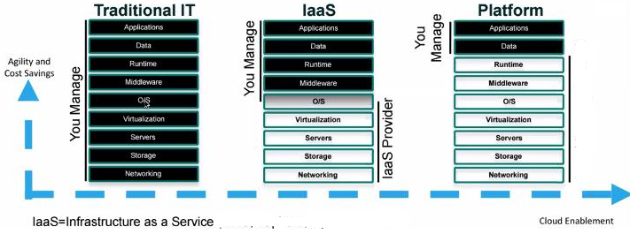
Source : cloudfoundry
Notes:
This is how the cloud enablement can affect your organizations agility and cost saving. Note that the “you manage” section is equal to man hours. The more you manage the more you pay for the time/skill of your manpower.

Slide 7
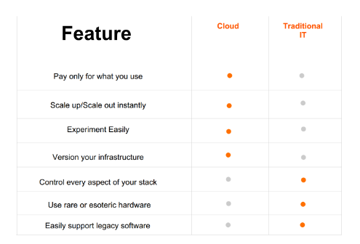
Source : alibaba cloud
Notes:
Other advantages of using cloud can be seen in this table.
Again, it will still be based on the study conducted by the organization to determine what implementation is best for their use case. Just take note of the advantages discussed and don’t forget to include them on your discussions.

Slide 8
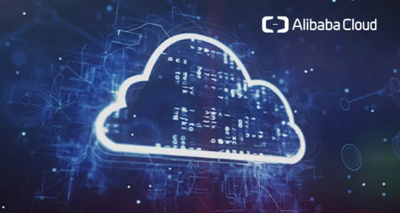
Who is Alibaba Cloud ?

Slide 9
Alibaba Cloud
Alibaba Cloud (Chinese: 阿里云; pinyin: Ālǐyún; lit.: 'Ali Cloud'), also known as Aliyun, is a Chinese cloud computing company, a subsidiary of Alibaba Group. Alibaba Cloud provides cloud computing services to online businesses and Alibaba's own e-commerce ecosystem. Alibaba Cloud's international operations are registered and headquartered in Singapore.
It was launched in September 10, 2009.

Slide 10
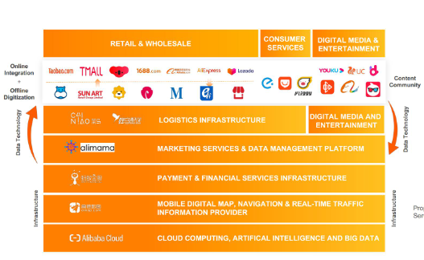
Source : alibaba cloud
Notes:
Alibaba Cloud is the main technology behind the Alibaba ecommerce platform

Slide 11
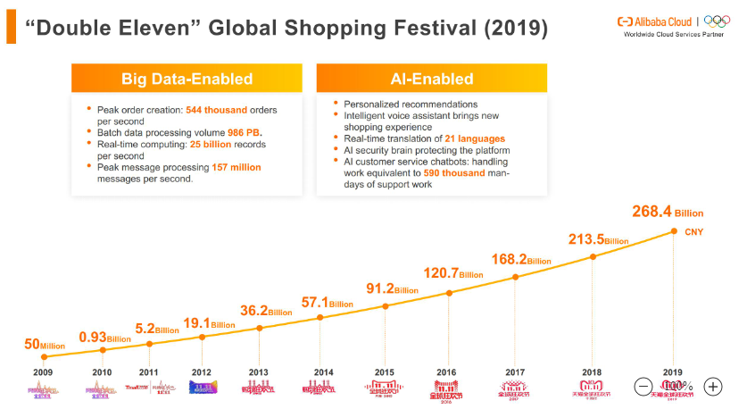
Source : alibaba cloud
Notes:
Double Elevent event is the true stress test for Albaba Cloud.

Slide 12
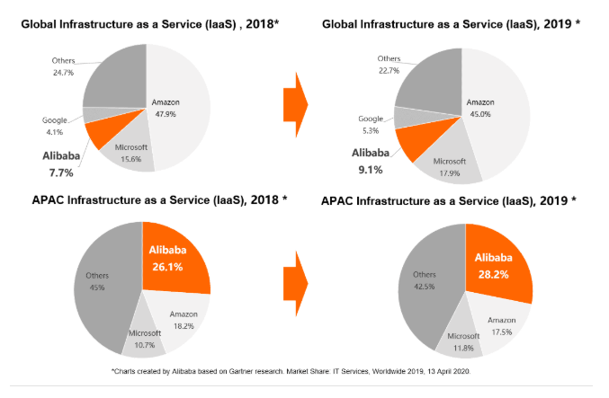
“In 2019, Gartner, the world's leading research and advisory company, named Alibaba Cloud as the 3rd biggest global provider for IaaS and first in the Asia Pacific.”
- Gartner Report
Notes:
Alibaba Cloud market share to IaaS

Slide 13
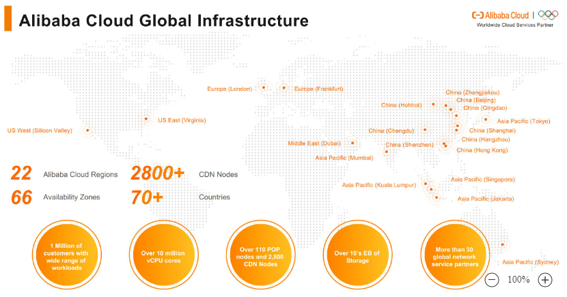
Source : alibaba cloud

Slide 14
Notes
Region is a separate geographic area.
Availability Zones are multiple, isolated locations within each Region. They are located in data centers, each of which have their own network and power grid within 1 region.
Some services are zonal concept(accessible per zone; e.g. VSwitch), regional (accessible in a region; i.e. VRouter) or global (across different regions; i.e. CDN or VPN or CEN)

Slide 15
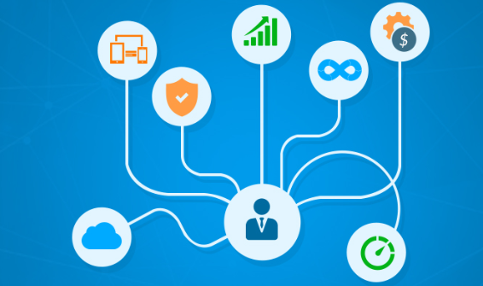
What are the services ?

Slide 16
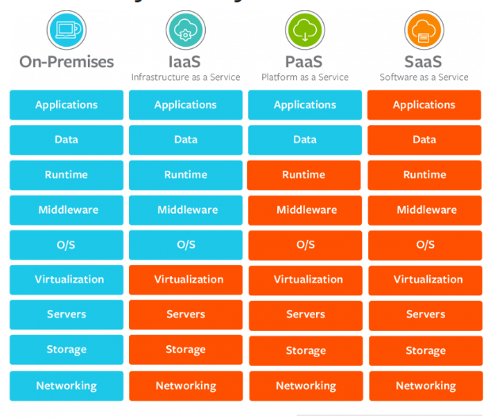
Service offerings
Notes:
Alibaba Cloud offers a lot of services from IaaS , PaaS and SaaS

Slide 17
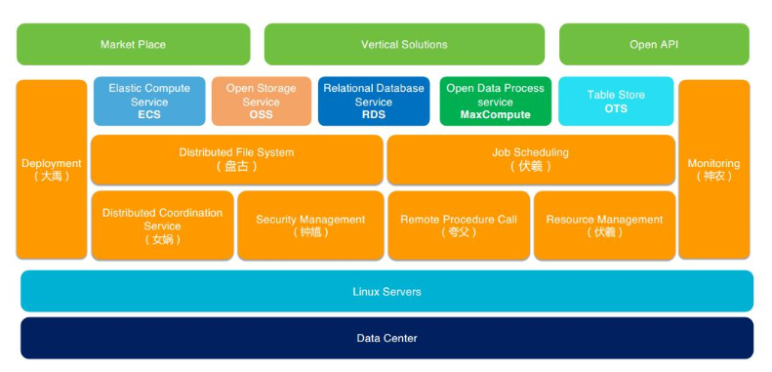
General architecture
APSARA
Source : alibaba cloud
Notes:
The main operating system that runs Alibaba Cloud is called APSARA
Shennong – Clod Monitoring
Fuxi – Job Scheduling
Zhongkui – Security
Nvwa – Distributed
Pangu – DFS
Dayu – Cluster Deployment

Slide 18
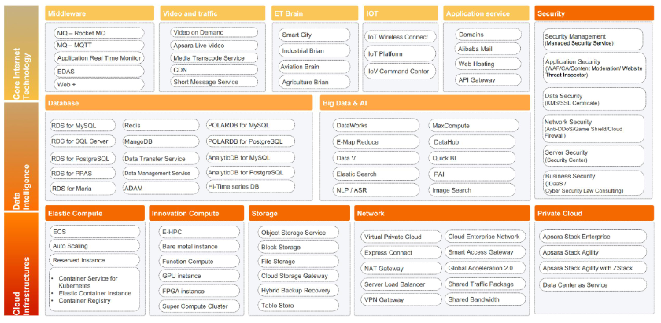
Source : alibaba cloud

Slide 19
Primary services
ECS – Elastic Compute Service
VPC – Virtual Private Cloud
SLB – Server Load Balancer
OSS – Object Storage Service
RDS – Relational Database Service

Slide 20
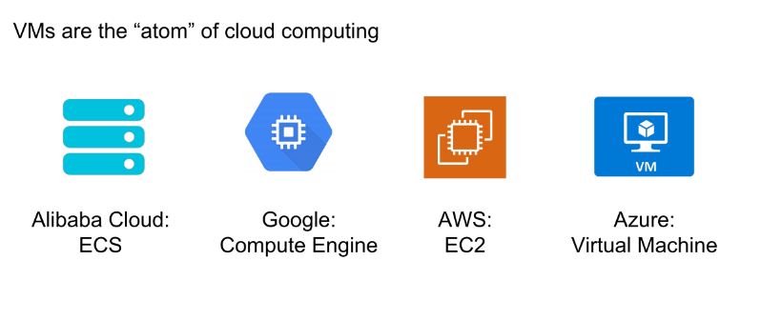
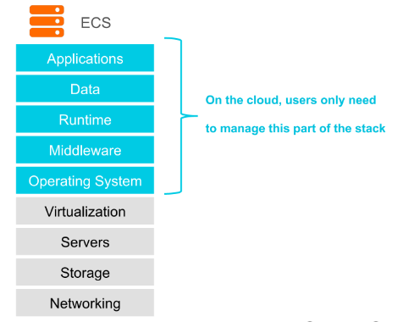
Elastic Compute Service
A computing service with flexible processing capacity. Compared to physical servers, ECS can easily deploy and manage applications with better stability and security. This can enable the business to focus on core businesses, not on maintaining physical infrastructure.
Source : alibaba cloud

Slide 21
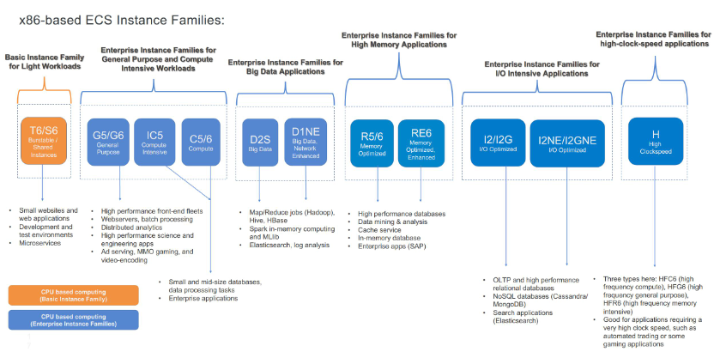

Slide 22
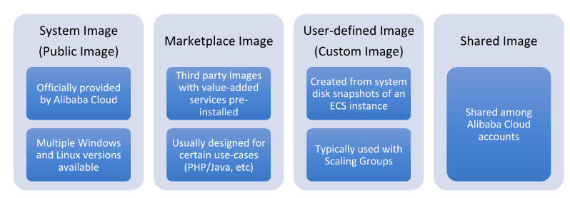
Source : alibaba cloud
Notes:
ECS can use different sources of images

Slide 23
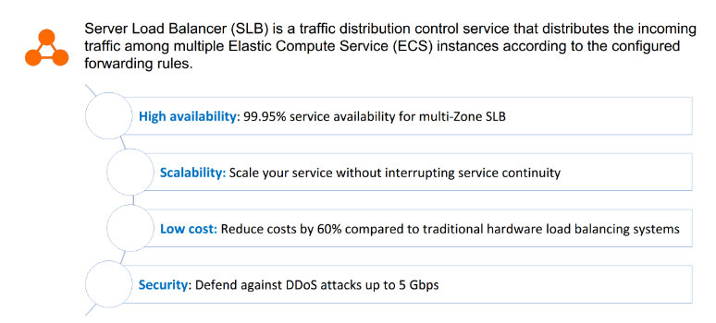
Server Load Balancers
Source : alibaba cloud

Slide 24
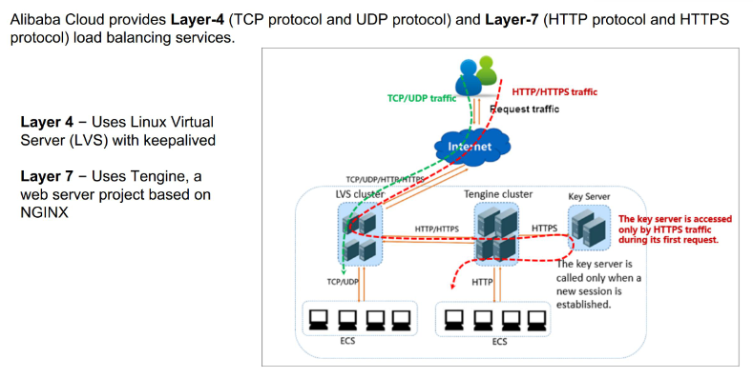
Source : alibaba cloud

Slide 25
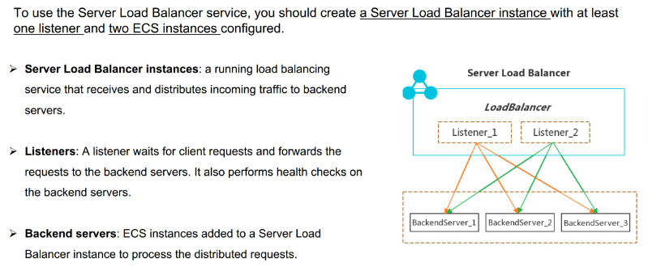
SLB components
Source : alibaba cloud

Slide 26
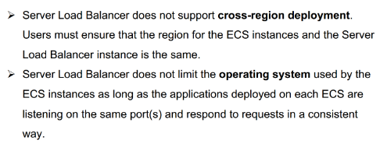
Limitations
Source : alibaba cloud

Slide 27
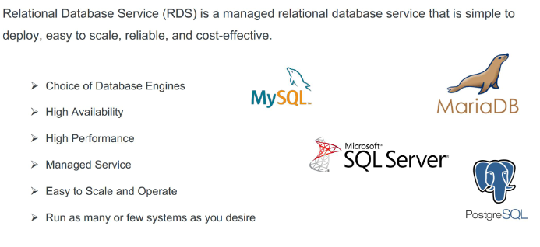
RDS – Relational Database Service
Source : alibaba cloud

Slide 28
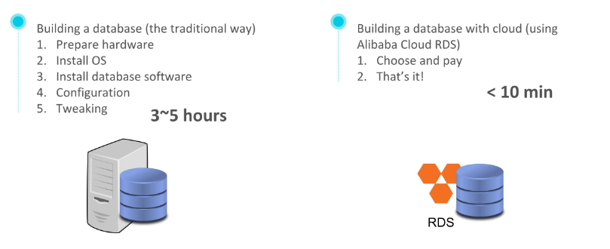
Advantages
Source : alibaba cloud

Slide 29
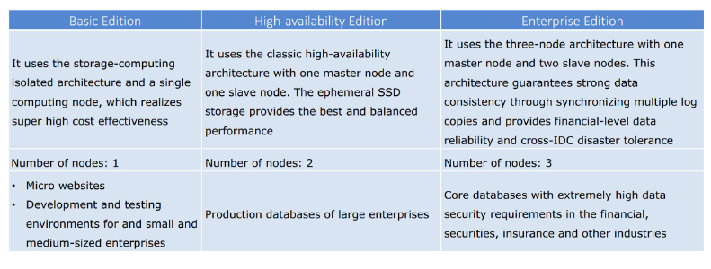
Editions
Source : alibaba cloud

Slide 30
Added features
Backup (Auto / Manual )
Disaster Recovery
Read Only Instances (for MySql)
Monitoring
Security
Migration
Source : alibaba cloud

Slide 31
OSS – Object Storage Service
An encrypted and secure storage service which stores, process and accesses massive amounts of data anywhere in the world.
Source : alibaba cloud

Slide 32
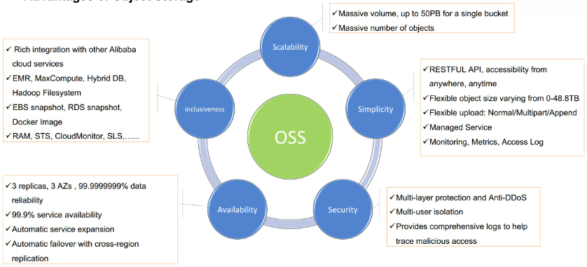
Source : alibaba cloud

Slide 33
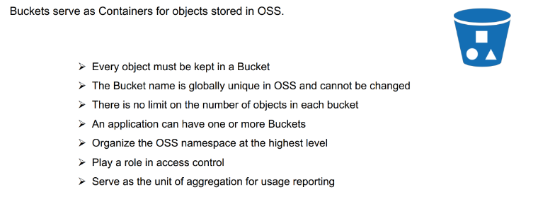
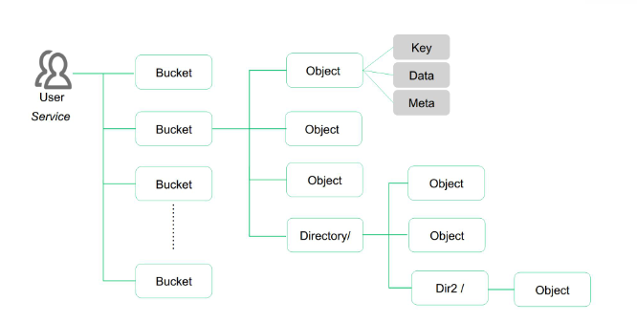
Buckets
Source : alibaba cloud

Slide 34
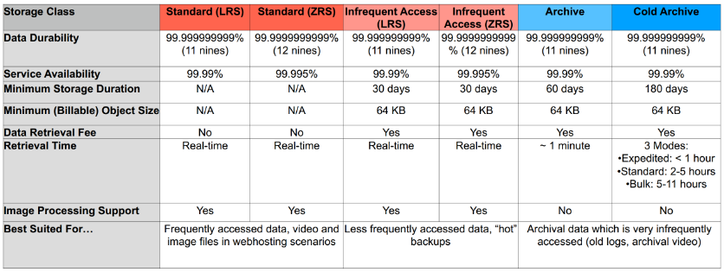
Storage classes
Source : alibaba cloud

Slide 35
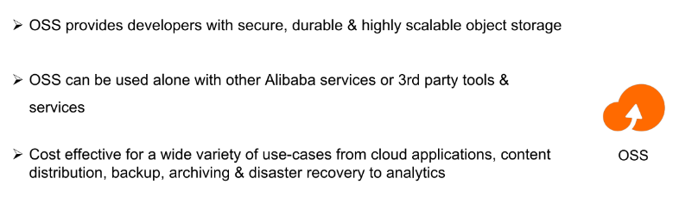
Source : alibaba cloud

Slide 36
Pricing schemes
Pay-as-you-go
allows you to pay only for the amount of resources you actually use
Subscription
Has multiple duration variation (1 month – 1 year)
Reserved instances
Is a discount coupon that can be applied automatically to one or more pay-as-you-go instances
Preemptive instances
Auto bid for prices
Source : alibaba cloud

Slide 37
Console
Source : alibaba cloud

Slide 38
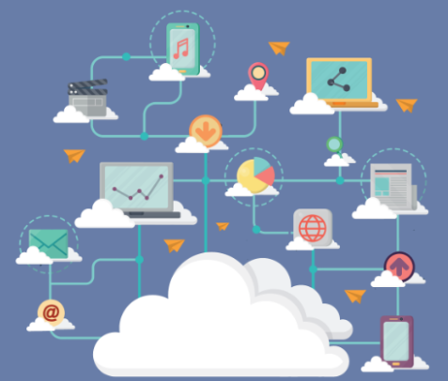
How can these services be used ?
Source : alibaba cloud

Slide 39
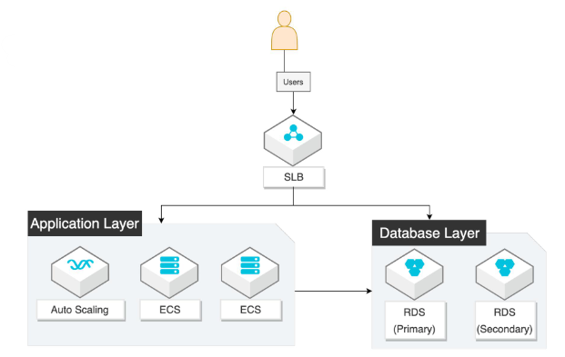
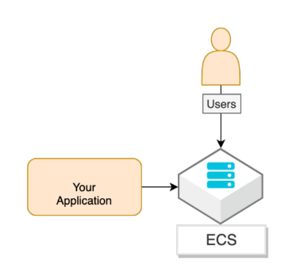
Basic usage
Source : alibaba cloud

Slide 40
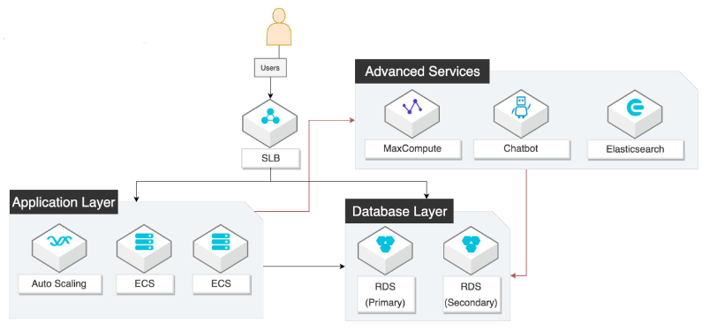
Advance usage
Source : alibaba cloud

Slide 41
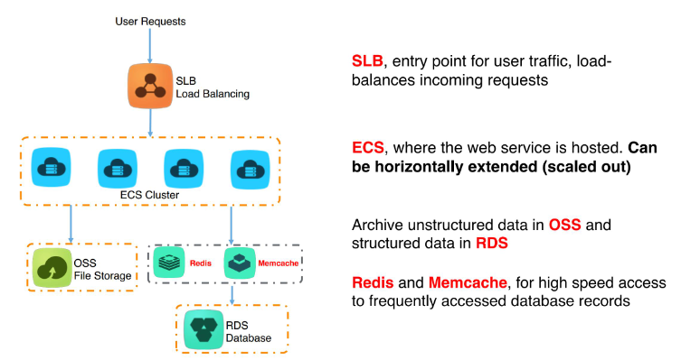
Simple architecture
Source : alibaba cloud

Slide 42
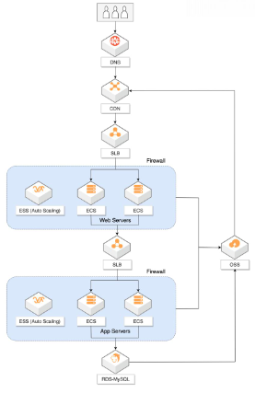
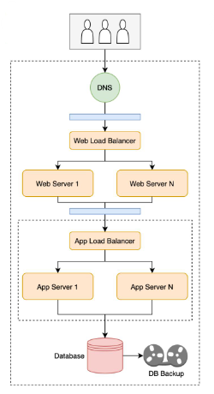
Traditional to Alibaba Cloud Architecture
Source : alibaba cloud

Slide 43
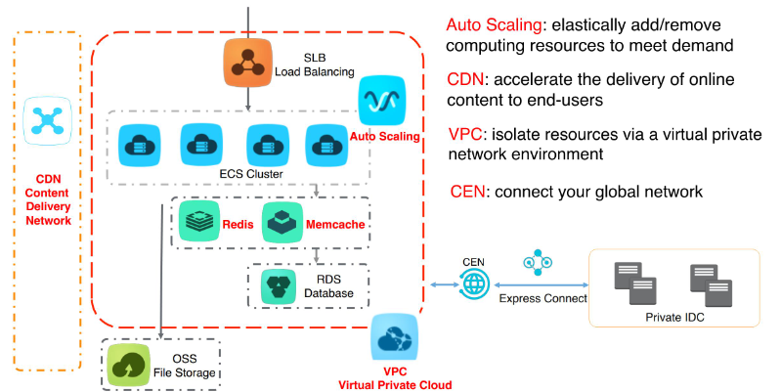
Scalable architecture
Source : alibaba cloud

Slide 44
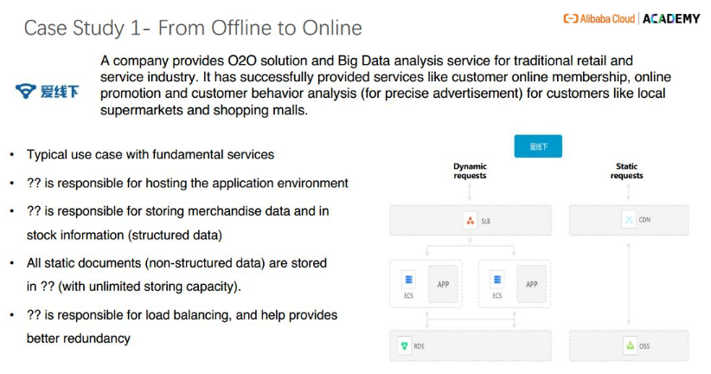
Source : alibaba cloud

Slide 45
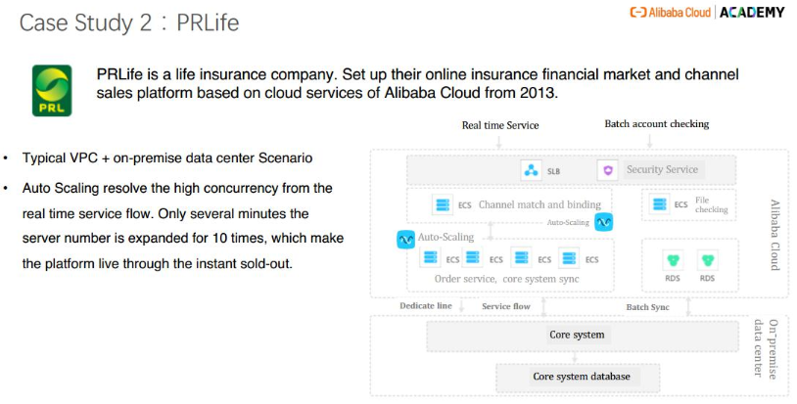
Source : alibaba cloud

Slide 46
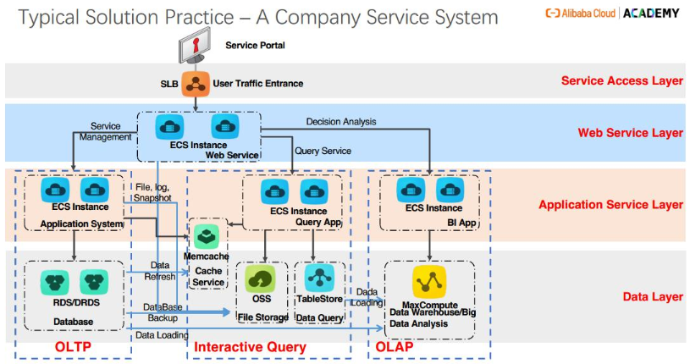
Source : alibaba cloud

Slide 47
Source : alibaba cloud

Slide 48

Where to learn more?

Slide 49
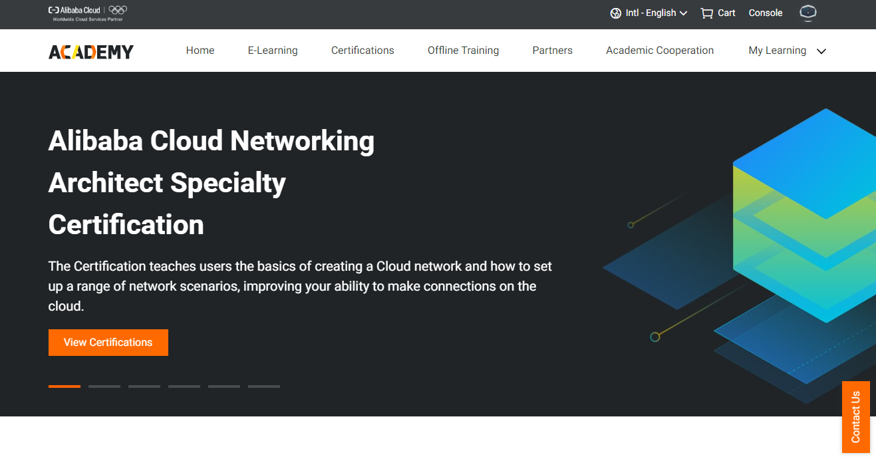
Alibaba ACADEMY

Slide 50
Q & A

